Slide 1
Projection
In case of Vertica, table is a logical entity. A projection is a collection of table columns.
Projections are physical storage for table data. There can be ‘n’ number of projections for a single table.
Data in a projection is compressed and encoded, making it optimized for query execution.
Vertica automatically creates projections on first data load into a table. We can create projections using the Vertica Database Designer or create them manually.
At query execution, the vertica’s optimizer chooses the best projection for the query.

Slide 2
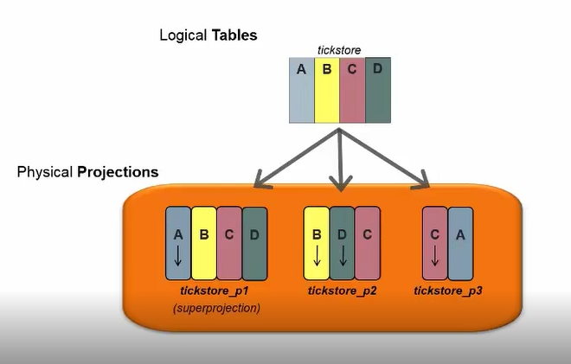

Slide 3
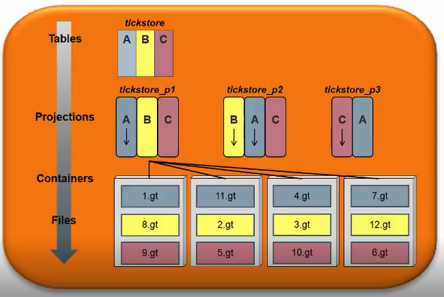
Vertica Object Hierarchy

Slide 4
Query Execution
SQL query is written against tables.
In order to execute a query , the vertica database generates a query plan. Query plan is the sequence of steps used to determine the execution path & resource cost for each step.
Cost calculated at each step in a query plan is the estimation of resources used like
Data distribution statistics
Disk space
Network bandwidth
CPU speed
Data segmentation across cluster
When you submit a query, the initiator chooses the projections to use, optimizes and plans the query execution. Planning and optimization are quick, requiring at most a few milliseconds.

Slide 5
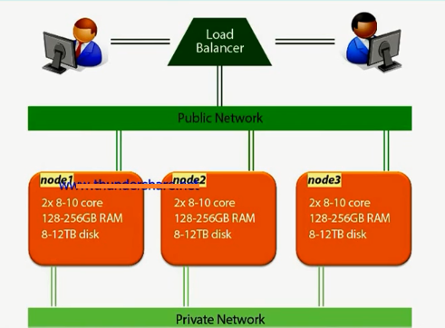

Slide 6
Based on the projections chosen, the query plan that the optimizer produces is decomposed into “mini-plans.”
These mini-plans are distributed to the other nodes, known as executors. The nodes process the mini-plans in parallel.
The query execution proceeds with intermediate result sets (rows) flowing through network connections between the nodes as needed.
In the final stages of executing a query plan, some wrap up work is done at the initiator, such as:
Combining results in a grouping operation
Merging multiple sorted partial result sets from all the executors
Formatting the results to return to the client
Some small queries, it can be executed locally. This avoids unnecessary network communication.

Slide 7
Vertica Transactions
A transaction is a sequence of operations, ending with COMMIT.
With every transaction, a transaction number (called epoch) is created. An epoch is 64-bit number that represents a logical time stamp for the data in Vertica.
The epoch advances when the data is committed with a DML operation (INSERT, UPDATE, MERGE, COPY, or DELETE).

Slide 8
Hybrid data store – WOS & ROS
Vertica is unique in many ways, one of which can be seen in its data storage model.
To understand the Vertica storage model, we first need to understand these three elements:
ROS (Read-Optimized Column Store)
WOS (Write-Optimized Row Store)
Tuple Mover
Vertica uses two distinct structures for storing data: WOS and ROS.
Vertica moves data from WOS to ROS using the Tuple Mover Entity.
The Tuple Mover performs two operations: Moveout and Mergeout

Slide 9
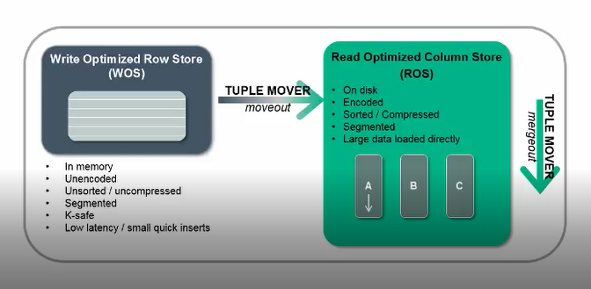
Hybrid Data Store: WOS & ROS

Slide 10
WOS
It is a memory resident data store.
Temporarily storing data in primary memory, speeds up loading process & reduce fragmentation on disk.
ROS
It is a disk resident data store.
When Tuple mover task , moves out into ROS: ROS containers are created and data is organized into projections on the hard disk.
Tuple mover:
Moveout
Vertica’s optimizer component that moves out data from memory to the disk (ROS)
Mergeout
It combines ROS containers on the disk

Slide 11
Why this Hybrid model?
To support different types of load.
If small frequent load or trickle load:
Then load to WOS
The data is WOS is still available for query result
Size of WOS: min{25% of available memory, 2GB RAM}
If data loaded to WOS exceed the size, the data is automatically spill over to ROS
i,e for Bulk load or large load : the best practice is to load directly to ROS

Slide 12
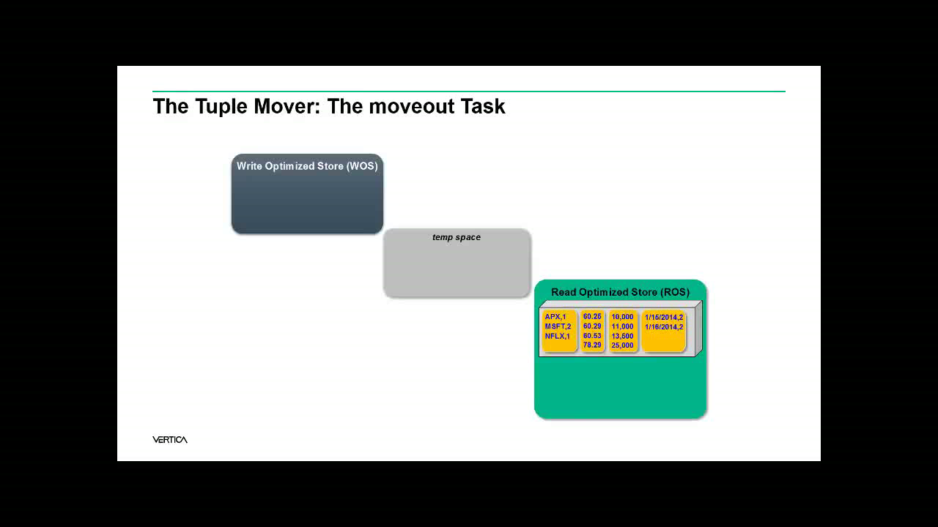

Slide 13
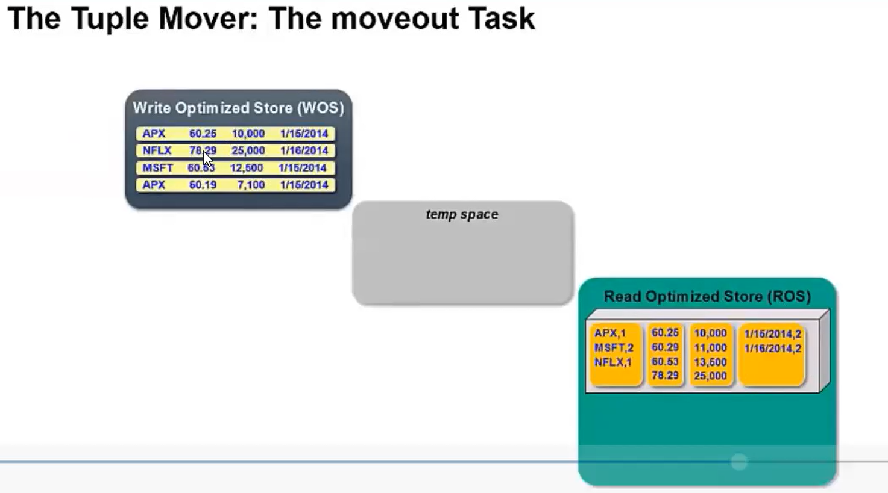

Slide 14
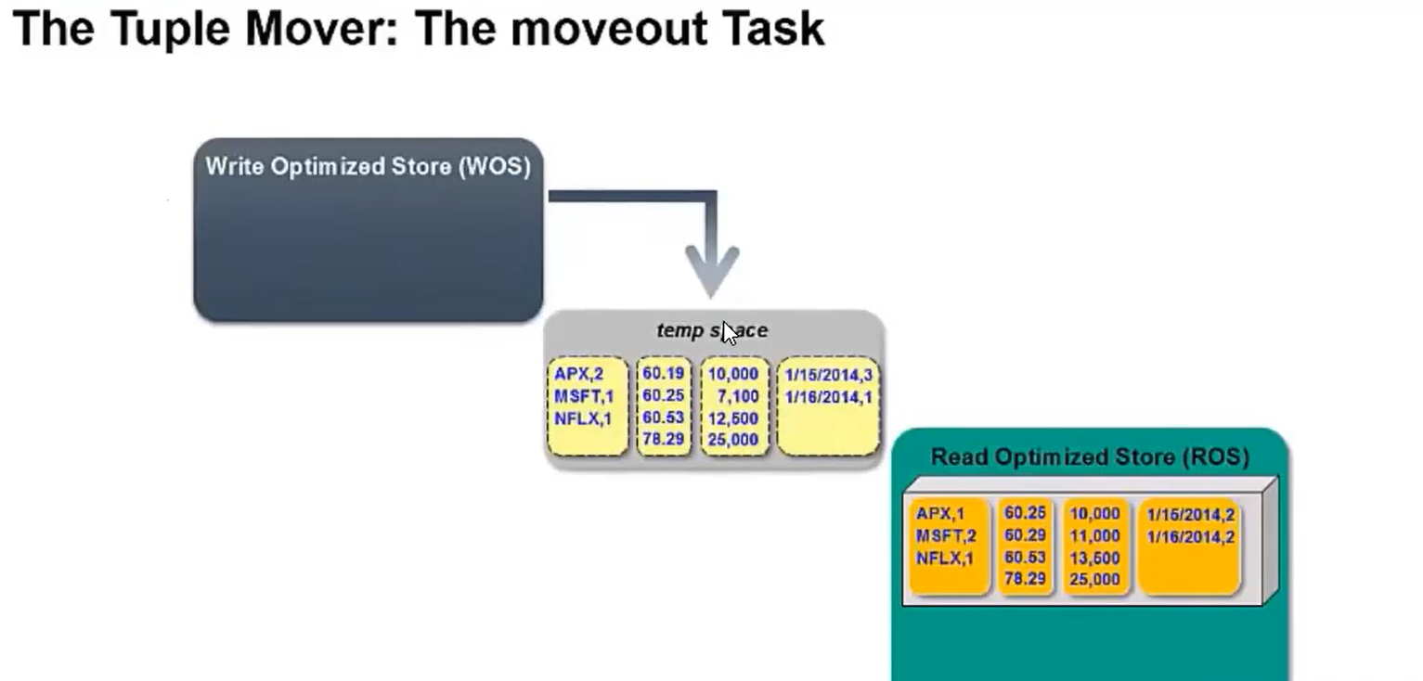

Slide 15
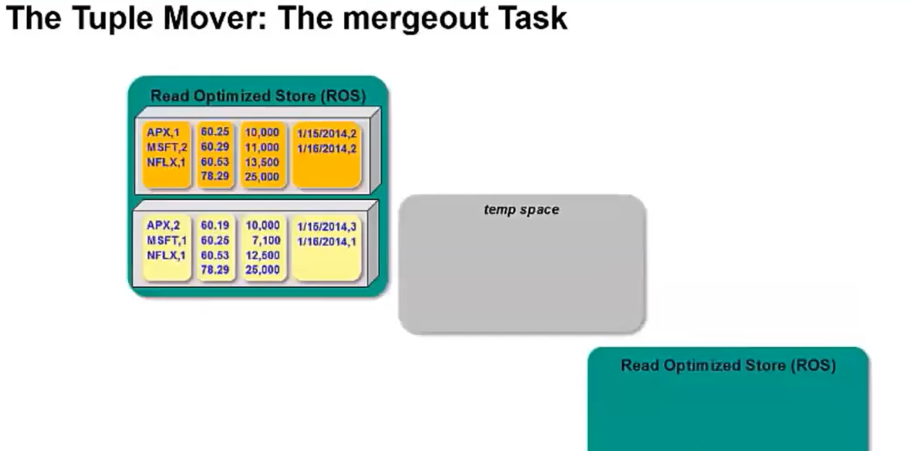

Slide 16
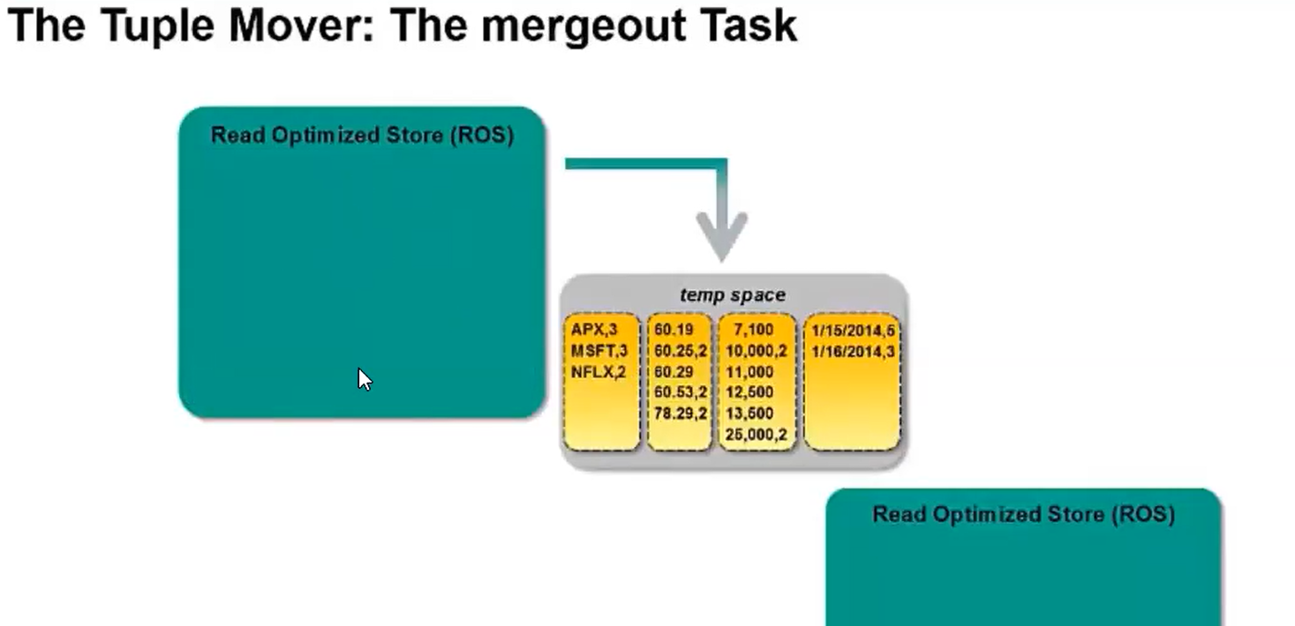

Slide 17
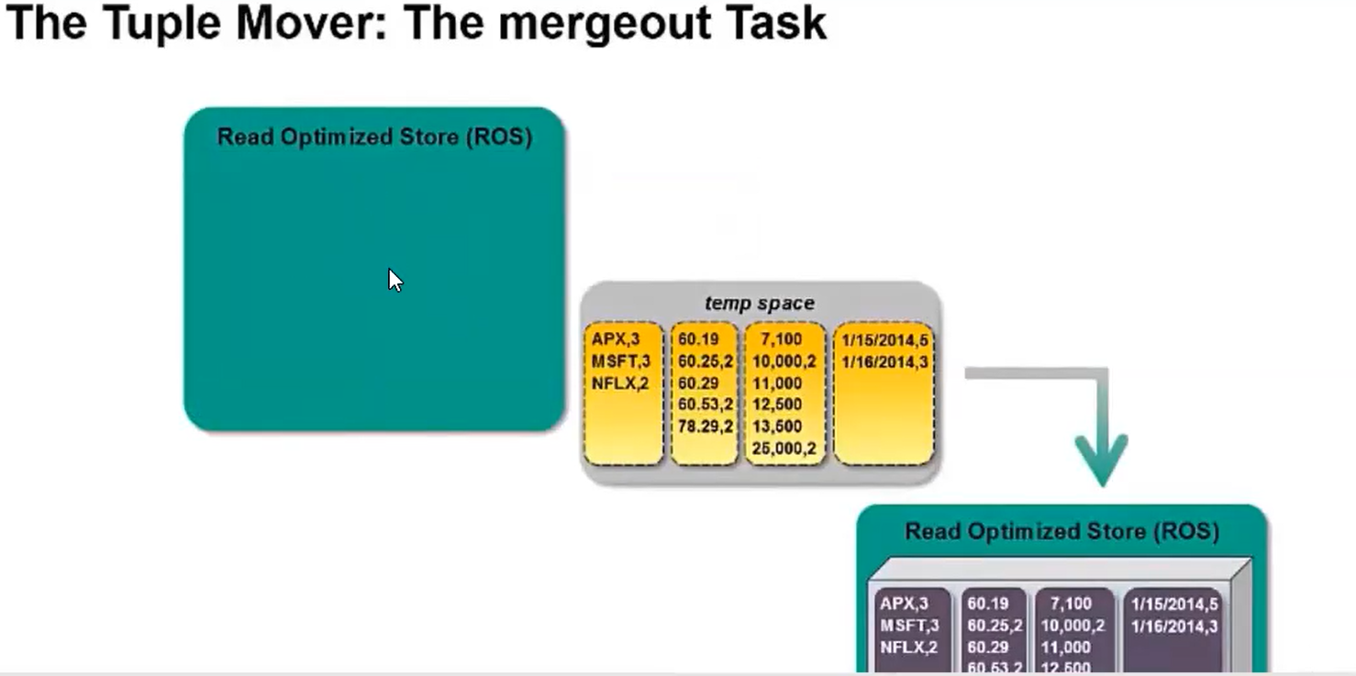

Slide 18
Projection Design
Projection fundamentals:
Data in a projection is compressed and encoded, making it optimized for query execution.
We can create projections using the Vertica Database Designer or create them manually.
At query execution, the vertica’s optimizer chooses the best projection for the query.
Vertica stores the projection data in ROS containers.
Logical grouping of all data files(data file + meta data file) on a node against a projection is called a container.
There can be more than one container for a single projection on a particular node. This happens because every time on insert or delete operation new data files are created and not appended to the older files. But this limitation is only for 10 min because after 10 min tuple mover will perform merge out action to merge all the containers of a single projection into bigger one.
We can have 1024 containers per projection per node.

Slide 19
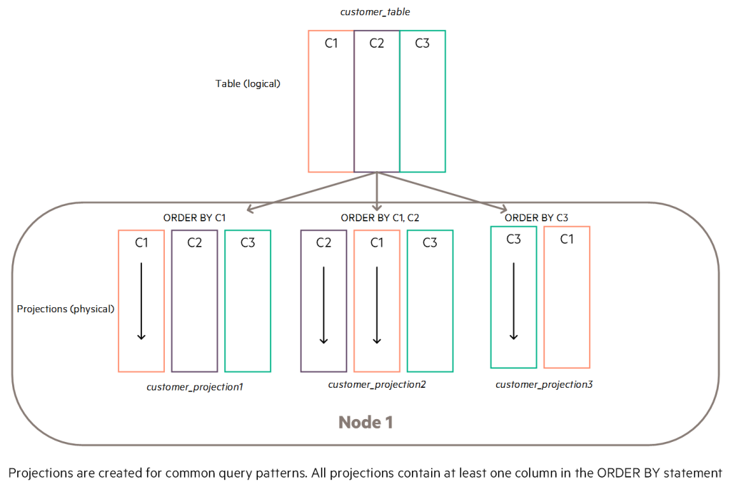
Projection Example

Slide 20
Projection Types
Projections are mainly classified into 5 types:
Superprojection
Query-specific Projection
Buddy Projection
Live Aggregate Projection
Pre join projection

Slide 21
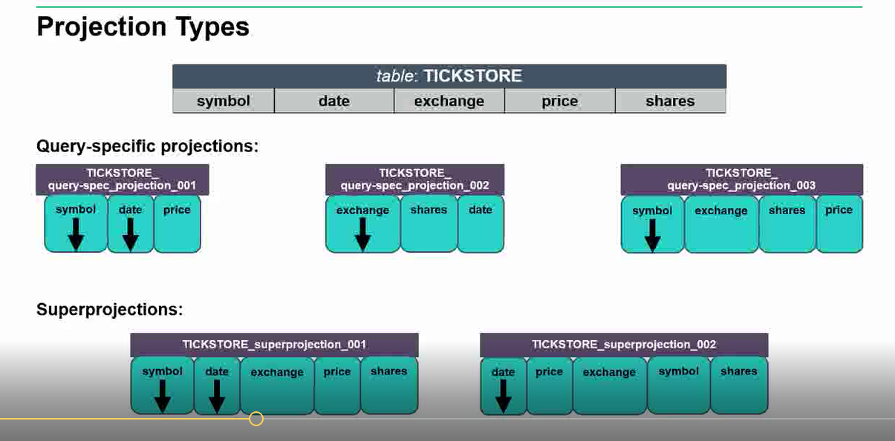

Slide 22
Superprojection
A projection that Vertica automatically creates when you initially load data into a table using INSERT, COPY commands.
A super projection contains every column of a table in the logical schema, ensuring that all of the data is available for queries.

Slide 23
Query-specific Projection
Optimized for a specific query or class of queries. It contains only the subset of table columns to process a given query.
Buddy Projection
A projection with the same columns and segmentation on different nodes to provide high availability.
Pre-join Projection
Manually created
Multiple tables are joined and stored in the form of projection.

Slide 24
Live Aggregate Projection
A live aggregate projection contains columns with values that are aggregated from columns in its table.
Manually created.
Functions Supported for Live Aggregate Projections
SUM
MAX
MIN
COUNT

Slide 25
Projection properties
Encoding/compression: Each column is always encoded, compressed or both. Vertica can work directly with encoded data but not with compressed data . Compressed data must first be uncompressed.
Sorting – order by: All projections contain at least one column in the ORDER BY statement.
ORDER BY A
ORDER BY A, B
ORDER BY B
B 1 1 2 2 3 3
A 1 2 1 2 2 1
C a d b e f c
A 111222
B 213132
C abacd f e
A 1 1 1 2 2 2
B 1 2 3 1 2 3
C a b c d e f

Slide 26
Projection Properties
Encoding/compression
Sorting – order by
K-safety
Replication and Segmentation

Slide 27
Replication and Segmentation
Vertica distributes data evenly on different nodes. There are two methods of distribution:
Replication: It is the process of copying the full projection to each node. This method is used for small projections such as projections with less than 1million records.
Segmentation: It is the process of segmenting and distributing the projection data across multiple nodes. This method is used for large projections.

Slide 28
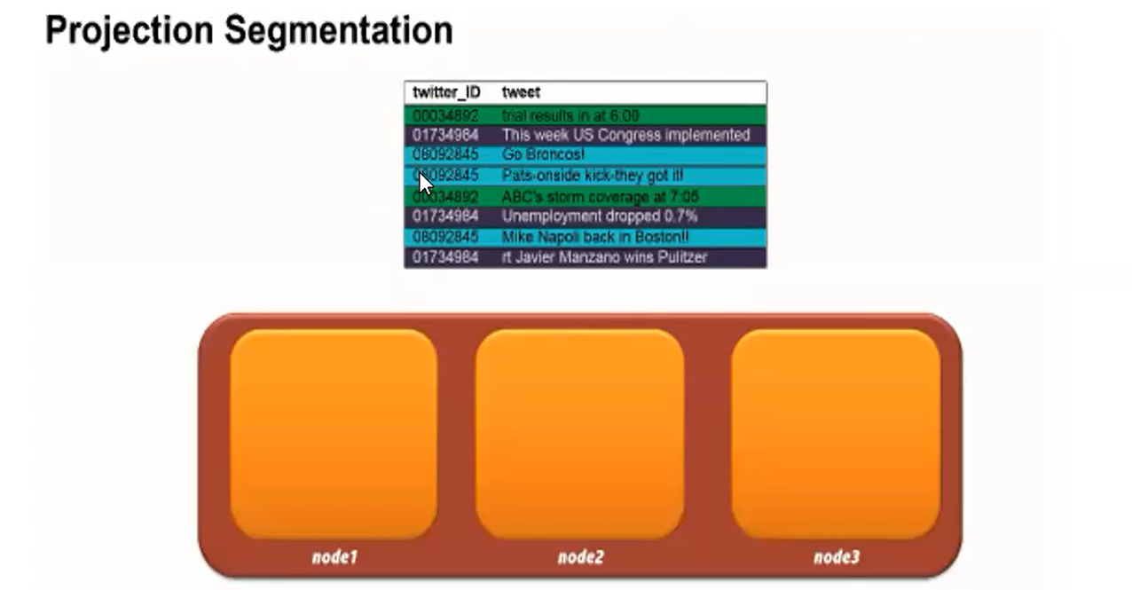

Slide 29
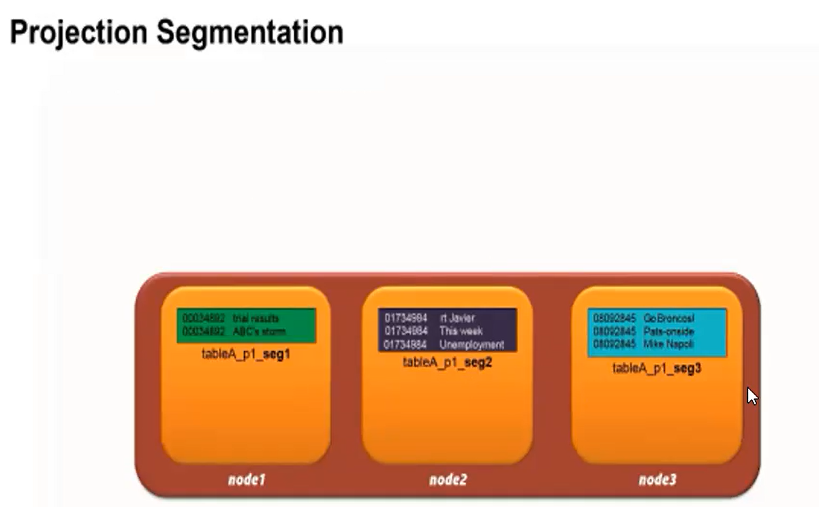

Slide 30
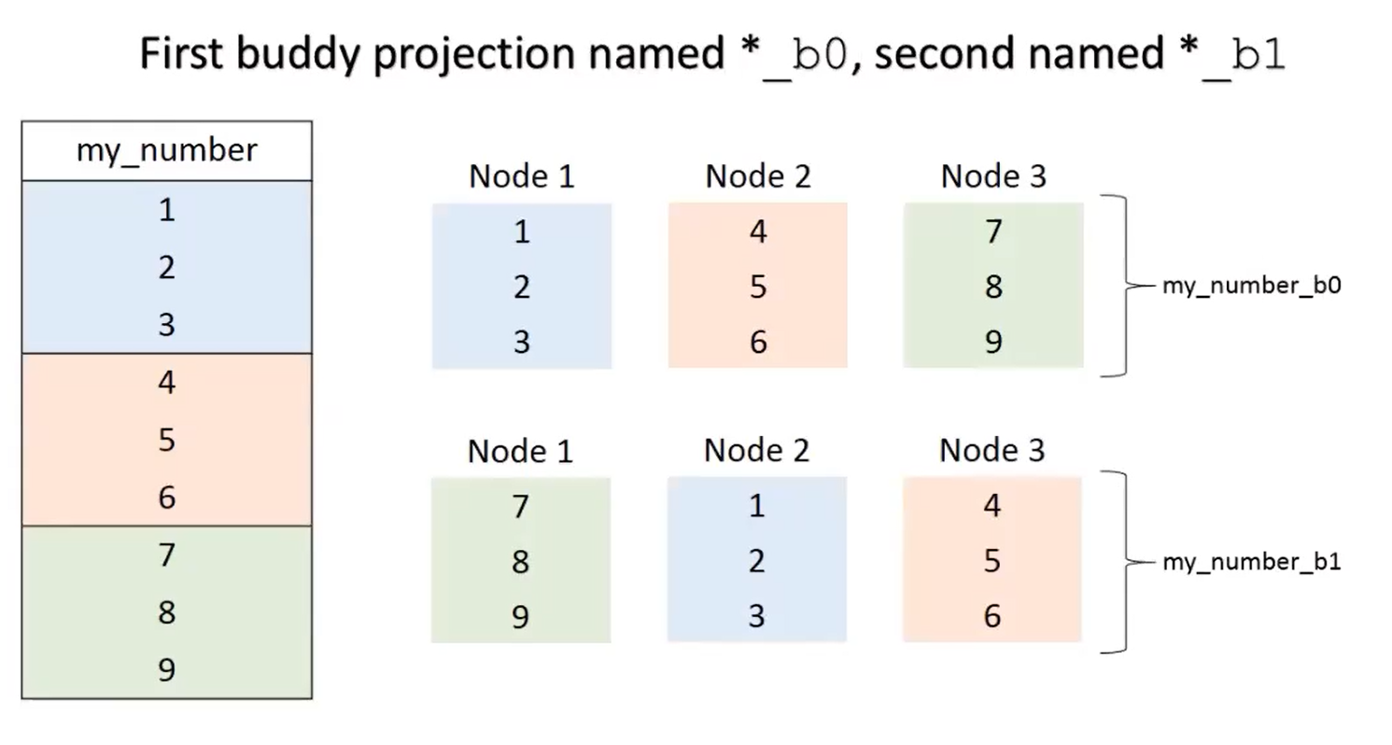
Buddy Projection

Slide 31
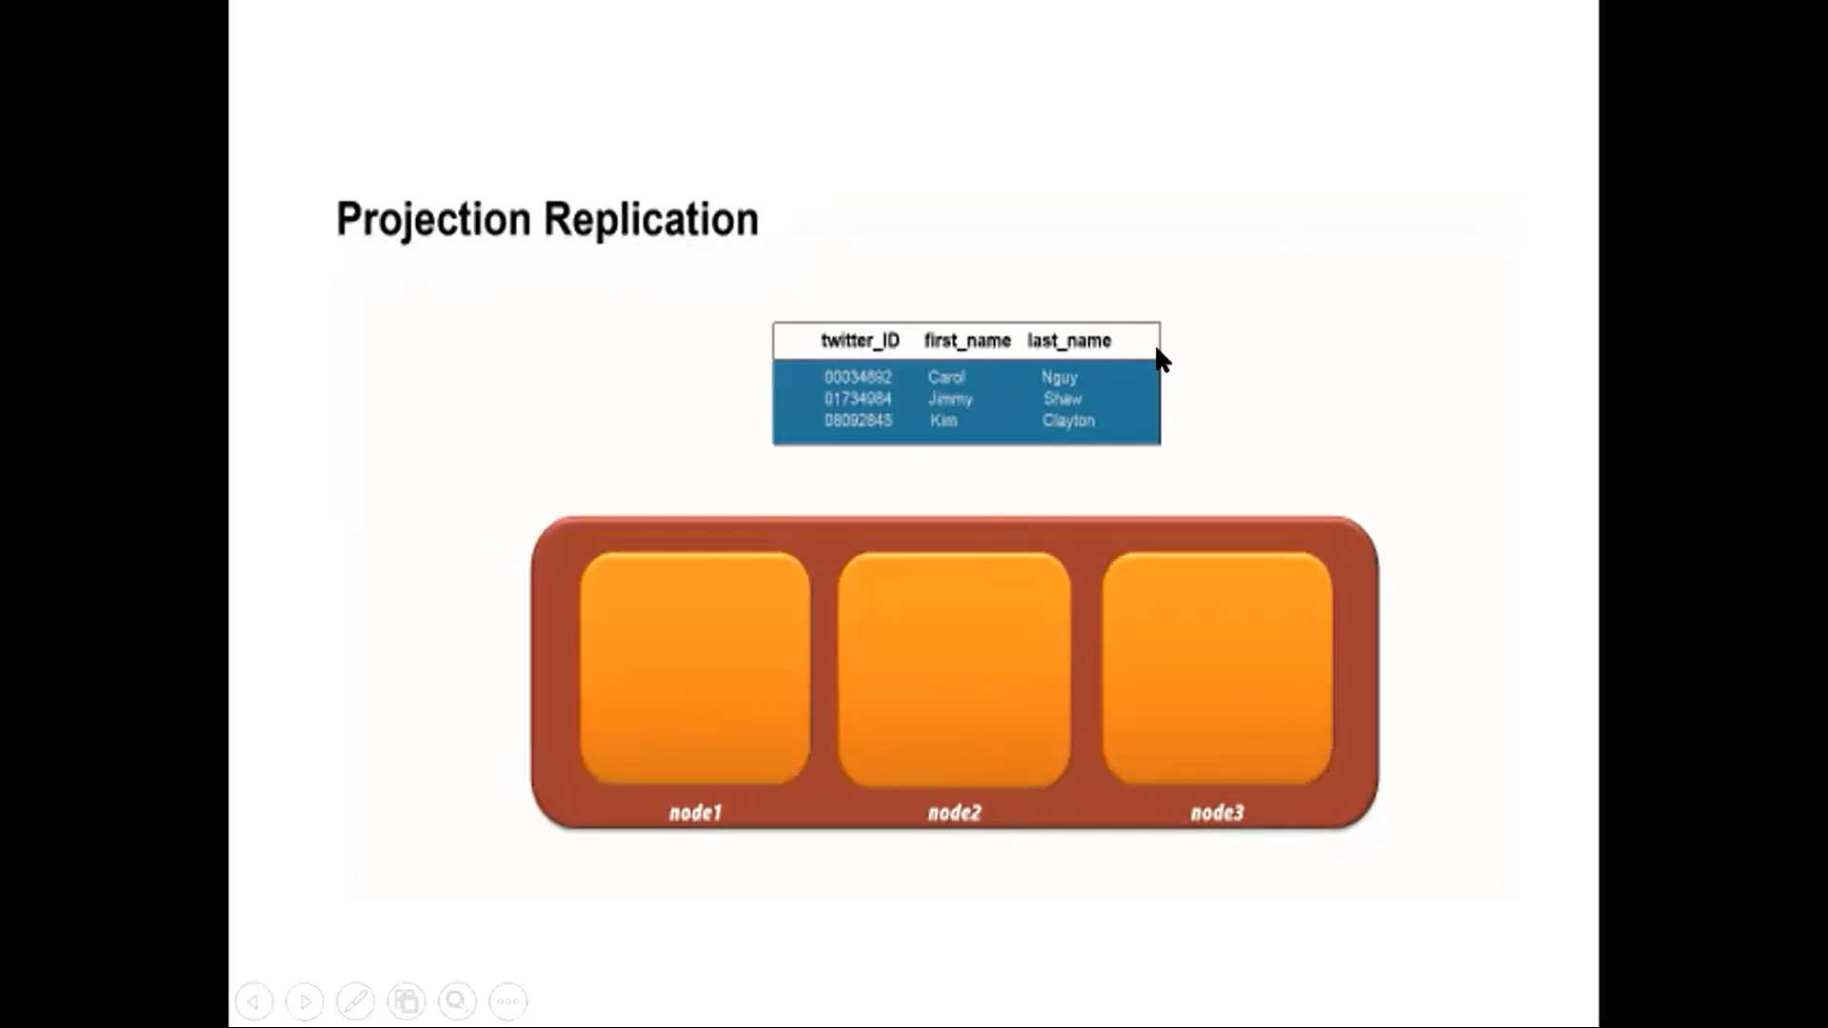
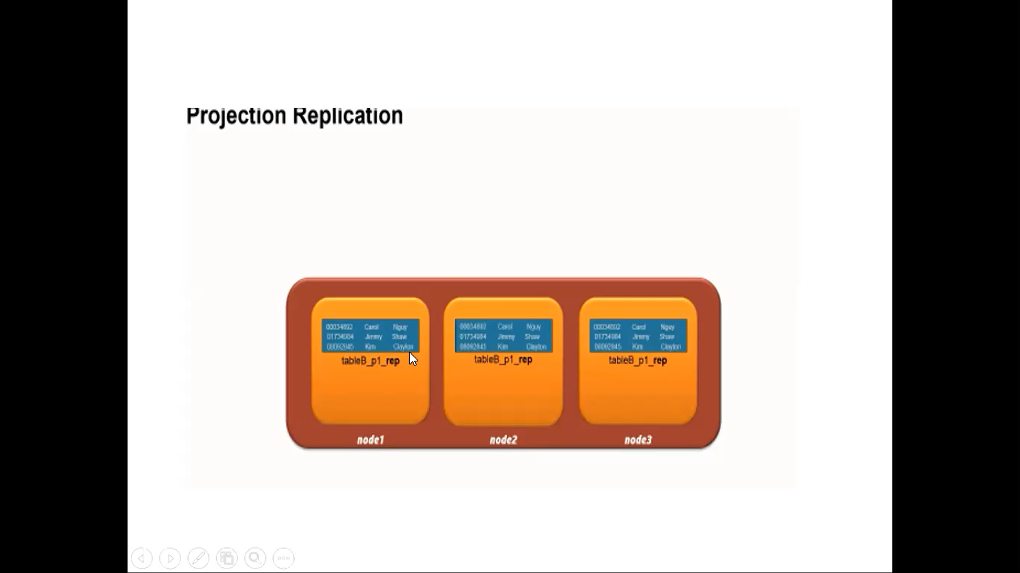

Slide 32
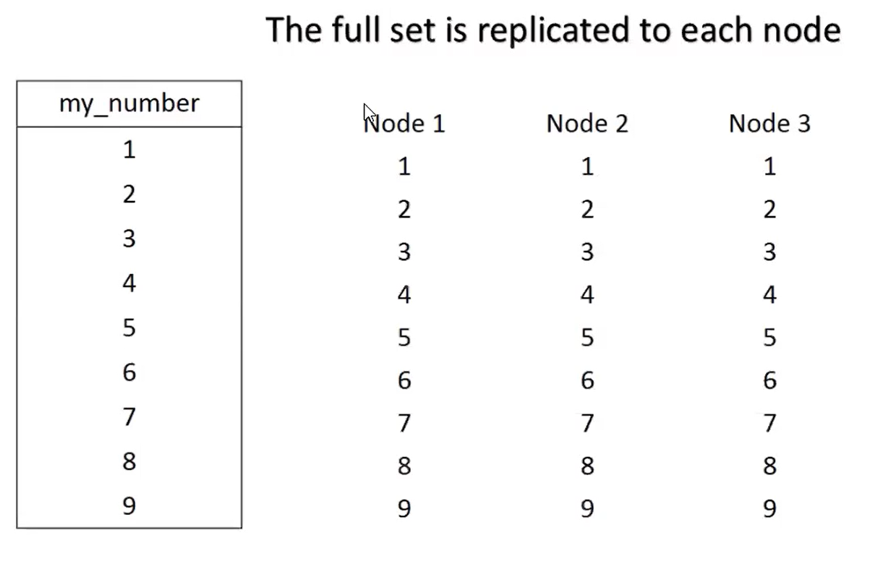

Slide 33
Creating projections
AUTOMATICALLY
Vertica automatically creates projections on first data load into a table.
These projections are considered unoptimized super projections.
RUNNING DBD
Optimized super projections are created when you run the Database Designer.
You also have the option of creating query-specific projections in the DBD wizard.
MANUALLY

Slide 34
MANUALLY
CREATE PROJECTION statement:
CREATE PROJECTION [ IF NOT EXISTS ]
...projection-name
... [ ( ........{ projection-col | grouped-clause
......... [ ENCODING encoding-type ]
........}[,...] ...) ] AS SELECT
...select‑list from-clause
...[ ORDER BY column-expr[,...] ]
...[ segmentation-spec ] ...[ KSAFE [ k-num ] ]

Slide 35
MANUALLY
CREATE PROJECTION projection_name (projection_col,...) AS SELECT table_col,... FROM existing_table ...
=> CREATE TABLE trades (stock CHAR(5), bid INT, ask INT); => CREATE PROJECTION tradeproj (stock ENCODING RLE, GROUPED(bid ENCODING DELTAVAL, ask)) AS (SELECT * FROM trades) KSAFE 1;

Slide 36
Hands-on (Module 2)
Creation of schema, tables and execution of SQL statements on Vertica Database
2. Hands-on projections

Slide 37
Connect to Remote Vertica Server
Click on putty (available on desktop)
Host name: 10.10.26.11
Login as : hp1
Password: ROOT@123
(login to vertica by giving the above user name and password)
Login to dbadmin by typing the following path
/opt/vertica/bin/vsql –Udbadmin –wvertica123
dbadmin=>
(now we can create tables and perform all the queries)

Slide 38
Database Designer(DBD)
Vertica's Database Designer is a tool that:
Analyses your logical schema, sample data, and, optionally, your sample queries.
Creates a Physical Schema design (a set of projections) that can be deployed automatically or manually.
Can be used by anyone without specialized database knowledge. Even business users can run Database Designer.
Can be run and re-run any time for additional optimization without stopping the database.
The projections that Database Designer creates provide excellent query performance within physical constraints while using disk space efficiently.
DBD can run in 2 modes:
Comprehensive mode
Incremental mode

Slide 39
DBD Advantages
Creates a physical schema design (a set of projections) that can be deployed automatically or manually.
Can be used by anyone without specialized database knowledge.
Can be run and re-run any time for additional optimization without stopping the database.
Provide excellent query performance while using disk space efficiently.
Accepting up to 100 queries in the query input file for an incremental design.
Accepting unlimited queries for a comprehensive design.

Slide 40
COPY
Loads data from files to Vertica
Faster approach to load a Data warehouse
AUTO spill over by default
Loads to WOS and spills to ROS if needed
By default, WOS= 25% or 2GB of RAM(which ever is less)
Used for trickle loading
Syntax :
COPY table [ column [ ,...] ]
FROM { 'file' | STDIN }
[ DELIMITER 'char' ]

Slide 41
COPY DIRECT
Best for infrequent or bulk loads
More efficient than AUTO.
No WOS involved
Can create ROS fragmentation if used for small frequent loads
COPY automatically COMMITS by default

Slide 42
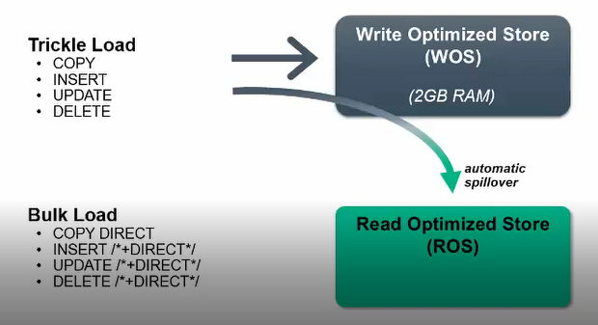

Slide 43
3 ways : COPY
Depending on the data you are loading, the COPY statement has several load methods.
You can choose from three load methods:
COPY AUTO
COPY DIRECT
COPY TRICKLE

Slide 44
MERGE
MERGE statements combine INSERT and UPDATE operations.
The source table can include new and existing data.
If the target table does not include any of the source table’s records (new or existing), MERGE inserts all source data into the target.
The following is a MERGE example with two MERGE options that you update (WHEN MATCHED THEN UPDATE…) or insert data (WHEN NOT MATCHED THEN INSERT…).
Updating one million records in two seconds.

Slide 45
Syntax:
MERGE INTO [[db-name.]schema.]target-table [ alias ] ... USING [[db-name.]schema.]source-table [ alias ] ... ON ( condition ) ... [ WHEN MATCHED THEN UPDATE SET column1 = value1 [, column2 = value2 ... ] ] ... [ WHEN NOT MATCHED THEN INSERT ( column1 [, column2 ...]) VALUES ( value1 [, value2 ... ] ) ]

Slide 46
MERGE INTO target TGT
USING source SRC
ON SRC.A=TGT.A
WHEN MATCHED THEN
UPDATE SET A=TGT.A, B=TGT.B, C=TGT.C, D=TGT.D, E=TGT.E
WHEN NOT MATCHED THEN
INSERT VALUES (SRC.A,SRC.B, SRC.C, SRC.D, SRC.E);

Slide 47
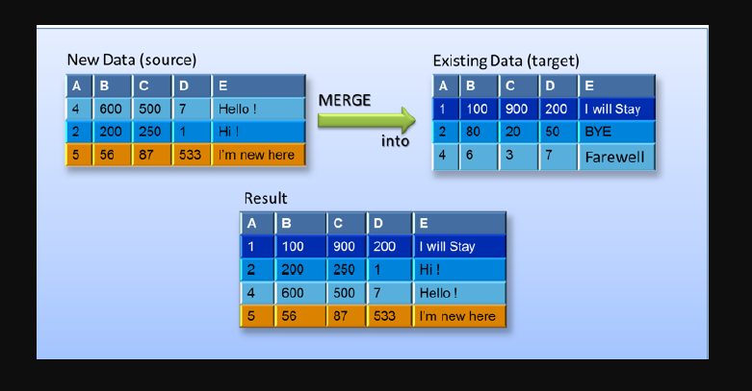

Slide 48
Purge
In HP Vertica, delete operations do not remove rows from physical storage.
The DELETE command in HP Vertica marks rows as deleted.
Purge is the process of removing the deleted data from disk.
Purge Permanently removes deleted data from physical storage so that the disk space can be reused.

Slide 49
Partitioning
HP Vertica supports data partitioning at the table level, which divides one large table into smaller pieces.
Partitions are a table property that apply to all projections for a given table. The Vertica partitioning capability divides one large table into smaller pieces based on values in one or more columns.
A common use for partitions is to split data by time. For instance, if a table contains decades of data, you can partition it by year, or by month, if the table has a year of data.
Partitions segregate data on each node to facilitate dropping partitions.
Partitions can make data lifecycle management easier and improve the performance of queries.

Slide 50
Differences Between Partitioning and Segmentation
There is a distinction between partitioning at the table level and segmenting a projection :
Partitioning—defined by the table for fast data purges and query performance. Table partitioning segregates data on each node. You can drop partitions.
Segmentation—defined by the projection for distributed computing. Segmenting distributes projection data across multiple nodes in a cluster.

Slide 51
The following diagram illustrates the flow of segmentation and partitioning on a four-node database cluster:
Example table data
Data segmented by HASH(order_id)
Data segmented by hash across four nodes
Data partitioned by year on a single node

Slide 52
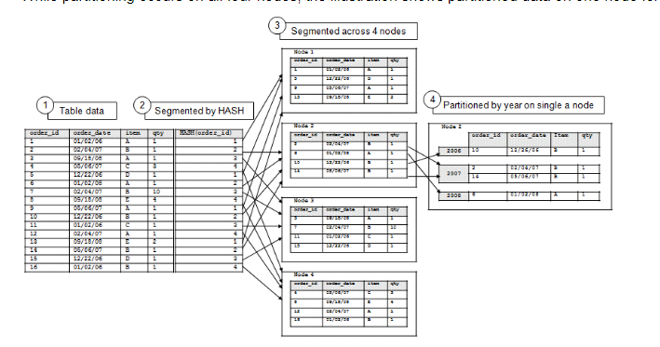

Slide 53
Hands-on (Module 3)
Loading data files from different sources to Vertica database.
Verifying the log files after loading the data into Vertica database.
Hands-on partitions.

